Slide 1








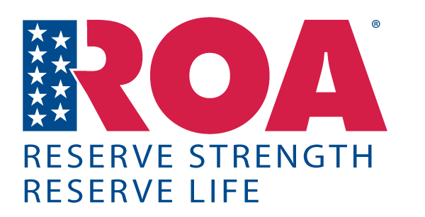












Professional Organizations
Notes:
As a military member, there are literally hundreds and probably thousands to choose from. They cover everything from total force to very specific one-item issues.
**Belonging to one or more is not only supported but encouraged by the Service Chiefs and DoD.
A few examples are: Army Chief of Staff General Mark Milley in his 2016 memo states “Mil Assoc represent an important dimension of our country’s strong interest in national defense” and “provide forums that foster military professionalism and development”. Previous Def Sec Chuck Hagel stated “are a critical component of our overall framework”. USCG PUB states “NMA support and promote the interests of our armed forces and military professionals.”
Removed on update in 2021.
DODI 5410.19 which spells out what can and can not be supported! DODI 5410.19 also spells out the difference between a “National Military Association” NMA and Non-Federal Entity NFE otherwise referred to as “professional military associations”!
There are only 9 approved as NMAs. (Adjutant Gen Assoc; Air Force Assoc.; Assoc of the US Army; Enlisted Assoc of Nat Guard; Marine Corps League; National Guard Assoc; Navy League; NCO Assoc of US; ROA. And those are the top ones you see on the slide.

Slide 2
What do they do?
Why should I join?
What do they want from me?
What do I get out of it?
What value do they have to me or the USCGR?
What / Why ROA?

Slide 3
WHY DO WE NEED A RESERVE SPECIFIC ORGANIZATION?
Notes:
Founded by Gen Pershing after WWI.
Did you realize that after WWI there was a movement in the USA to completely eliminate all military equipment and manning?
It was thought that the large build-up was partly the cause of the war so if you eliminate the build-up of forces you will not use them!
ROA is the only one that includes all 8 commissioned services and reserve ranks.
Yes, 8 services have “commissioned” officers.
Who can tell me all 8? Prize for the 1st to name all 8.
Established in 1922.
For 100 years ROA has been the only organization solely dedicated to supporting the Reserve Components and their critical role in national defense.
Lets look at some recent history of reserve involvement.

Slide 4
Reserve/Guard Actions
World War I 1917-1920
World War II 1941-1945
Berlin Airlift 1948
Korea 1951-1953
Cuba 1962
Vietnam 1965-1973
Cold War 1948-1989
Iraq Conflict 1990-1991
Iraq No Fly Zone 1991 2000
Rwanda/Bosnia……….
Somalia, Haiti………...1990’s
Kosovo…………………
Iraq………………2002-2011 Afghanistan………..2002-2023
Ukraine…………....2023
Notes:
Yes, reserves have been used and continue to be a huge part of our national defense.
So how many are mobilized currently?

Slide 5
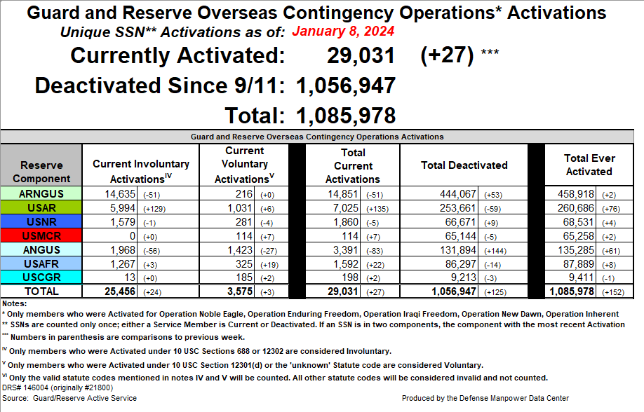
Notes:
Here is where we sit today. Note that USCGR totals 9,411! 3,000 more than we have now!
The last “draft” was in 1974 so anyone under the age of 67 has never really had to worry about involuntary service.
The 1st large test of an all-voluntary force came in 1990 for Desert Shield and Storm where the reserves literally replaced the need and use of a draft.
So how much do people think about us?
The public?
Congress?
How do we get what we need?

Slide 6

What we get and how we get PAID!
Legislative Process
New Congress every two years (January)
Receive President’s budget (February)
Committee hearings/staff work (March-May)
Committees important to defense:
House Armed Services (HASC)
Senate Armed Services (SASC)
House and Senate Appropriations
Subcommittees on Defense (HAC-D/SAC-D)
ROA has considerable credibility with the committees
and individual congressional members and their staffs.
Congressional members need to hear from their constituents on matters of national security.
Notes:
**So, how do we get reserve issues and needs addressed?
Do you think Congress just says hey what do the part-time people need?
Everything we get or have is through the legislative process.
With so many vet & military organizations whom do they trust?
Whom do they listen to or go to for advice or concerns? Who has a history of issues and projects?
We must be involved in Educating Congressional Members.
Individual stories and issues matter! Or groups that represent them!
Location, location, location! ROA HQ is on Capitol Hill. They see it every day they walk to work!
This is the view from our Executive Directors’ office! Right on the corner across from the Russell, Dirksen & Hart Senate buildings, with the Supreme Court on the other side and our front door facing the Capitol Building.
Communications and availability is key.
The most influential way to a congressional member is from their Constituents!
So who are they and how many of them are veterans or reserve or guard members?

Slide 7
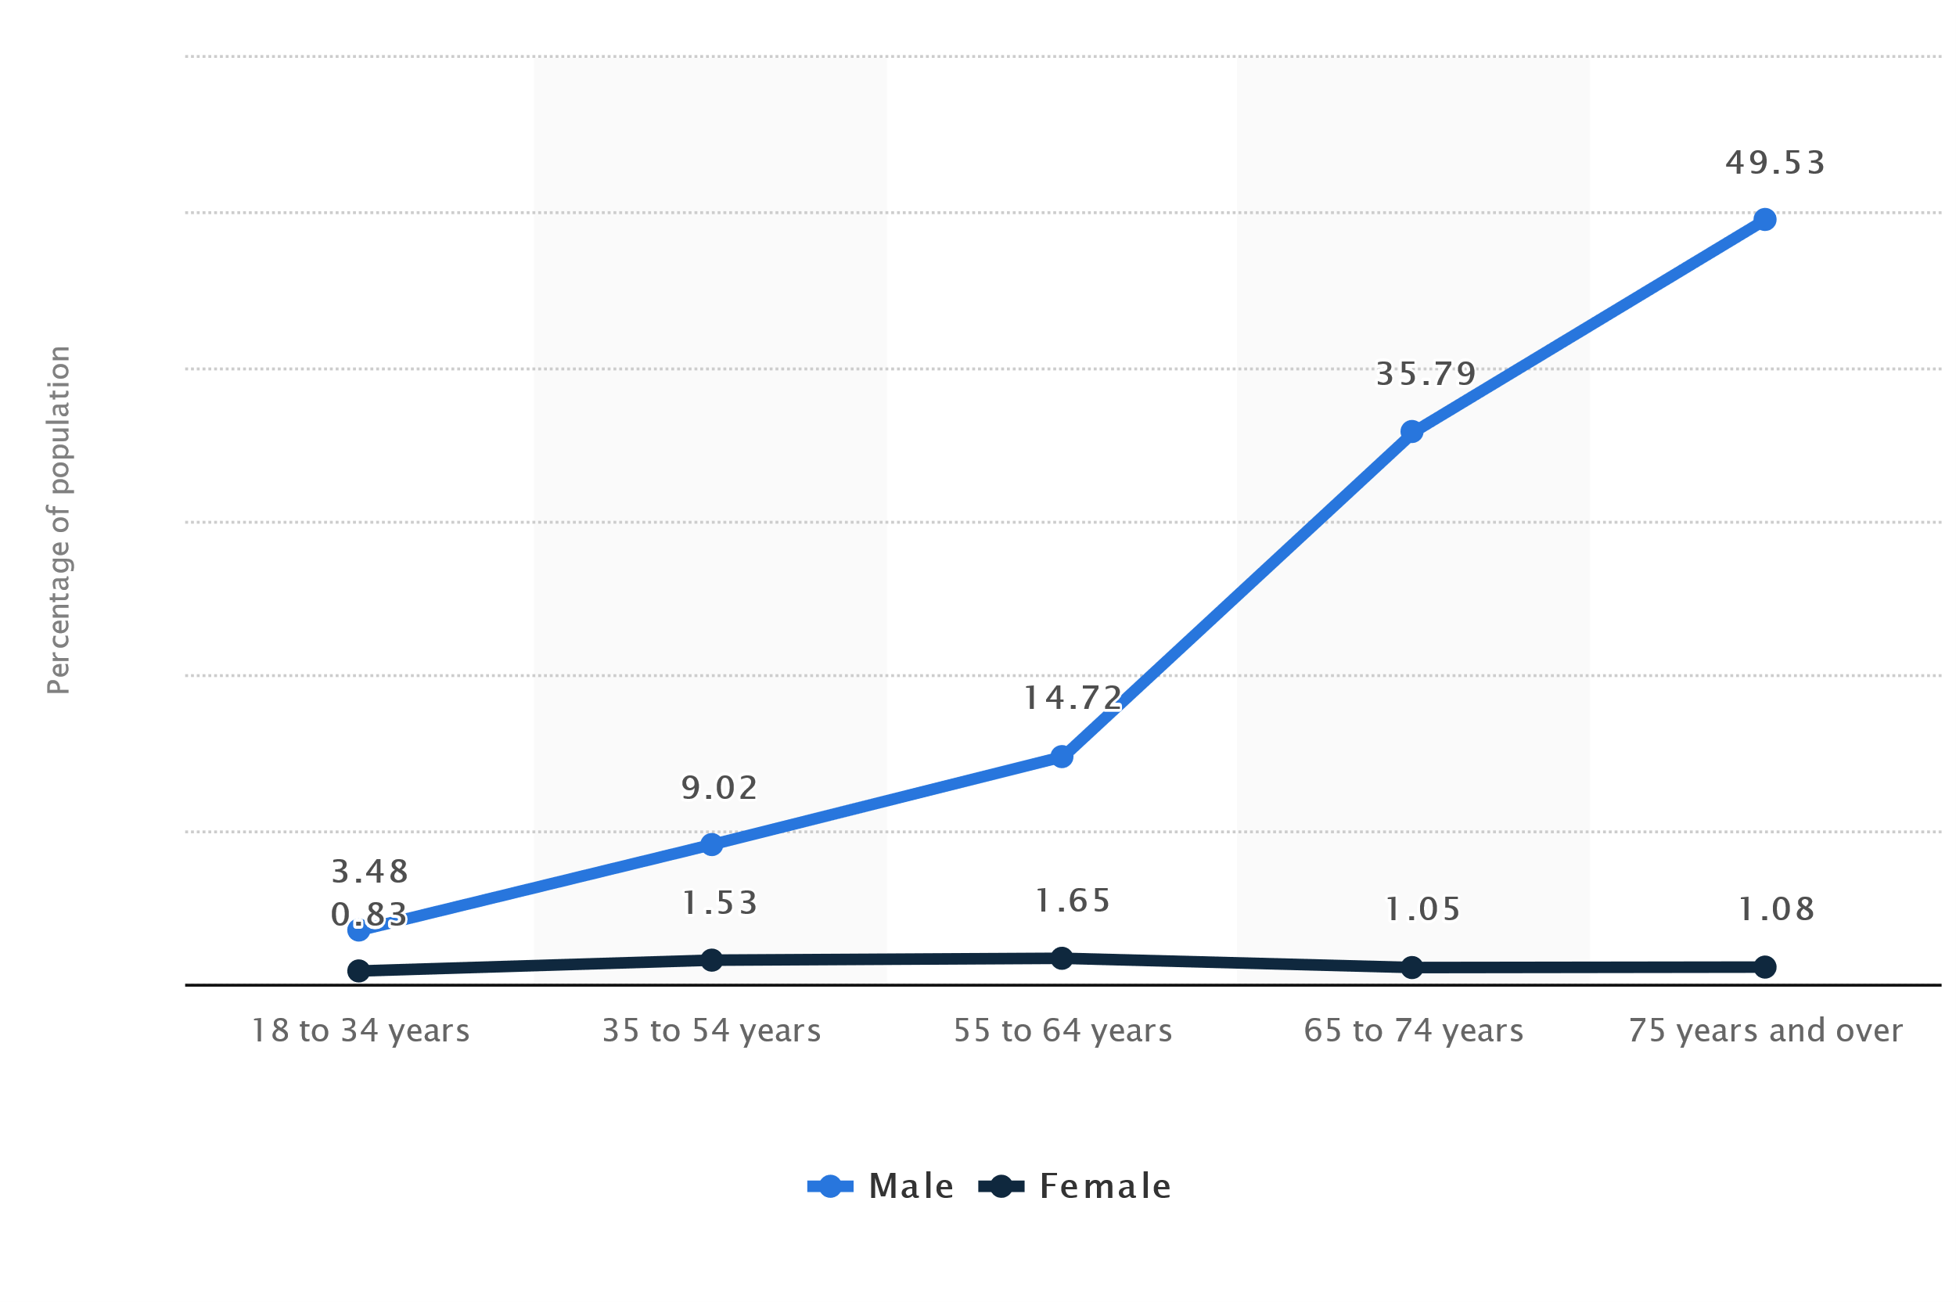
Notes:
Percentage of U.S. population who are veterans in 2017 by age and gender.
The share of the U.S. population with military experience has declined, according to data from the U.S. Census Bureau. In 1980, about 18% of U.S. adults were veterans, but that share fell to 6% in 2022.
Among veterans, 7.3 percent are women. According to the Department of Veterans Affairs, women are the fastest-growing subpopulation within the veteran community.
Fewer than 120,000 World War II veterans are alive today, making up less than 1% of all living veterans.
Around 767,000 veterans who served during the Korean conflict in the 1940s and 1950s are alive today. They make up 4% of all living veterans.
Nearly one-half (49%) of all veterans in the United States are now 65 years or older.
This means well over half are now over the age of 50!
The largest cohort of veterans alive in 2018 served during the Vietnam Era (6.4 million), which lasted from 1964 to 1975. The second-largest cohort of living veterans served during peacetime only (4.0 million).
The median age of veterans in 2018 was 65. By service period, Post-9/11 veterans were the youngest with a median age of about 37; Vietnam Era veterans had a median age of about 71; and World War II veterans were the oldest with a median age of about 93.
https://www.census.gov/newsroom/press-releases/2023/aging-veterans.html
So why does this matter to me or the USCGR?

Slide 8
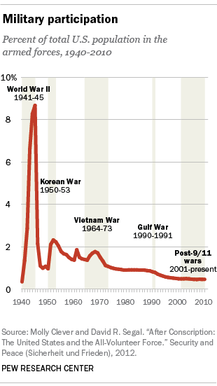
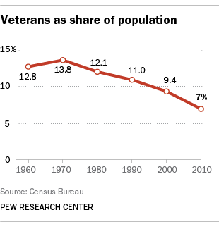
Who elects representatives?
Notes:
We need to look at reality and the numbers. We are now at 6%. Sorry no updated graph from PEW.
Whom should congress represent and put priorities on?
Why prioritize or give preference to less than 6 percent of the voting population?
Numbers matter to Congress! How many of the members belong to ROA? Any other military organization?
If non-issue for reservists why listen to that organization?
So why do representatives care about military members or reservists? Lip service?
Military, of course, no one is going to say they are not supportive of the military.
But what “Military members?” Almost everyone automatically thinks of active duty.
Veteran preference! Yes, everyone loves the vets.
But what about the serving reservists? What are the preferences for a serving reservist?
Before the CAC card reserve members got no consideration from retailers or even military bases with a pink ID!
Hiring or promoting factors? Look at the definition of a “veteran”. You may not qualify as a reservist without a DD214.
Do they even know how many reserve members are in their district?
Oh wait, maybe they care because they were once in the military!

Slide 9
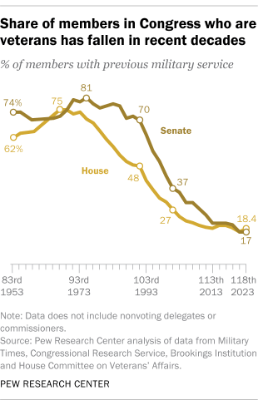
118th Congress
House 435
219 R, 212 D, 4 V,
80 members 18% who have served or are serving in the U.S. military.
Senate 100
49 R, 48 D, 3 I,
17 members who have served or are serving in the military.
Notes:
The 118th Congress is made up of 80 current members in the U.S. House of Representatives who have served or are serving in the U.S. military.
Senate side, 17 are serving or have served in the military — Tom Cotton of Arkansas is one.
Over the past 25 years nearly every congressional delegation has had fewer veterans than the previous group.
Bottom line. Not a lot of them know or understand military let alone reserve issues.
And… The Staffers that provide input to the members average age is around 25 with NO military background or experience.
Funding, pay, benefits, size of forces, how we are promoted/advanced all comes from Congress.
WHO submits the budget?
Active duty will always default to wanting a larger and stronger active component over or instead of reserve items and personnel.
Military Fellows and Legislative Assistants from every service are assigned to key members and committees. It helps, but guess which military members are selected? Very few are reserve members, so how much do your active-duty compatriots know about reserve issues? Or even know what they do?
This is why it is vital to join the active duty groups as well and educate them about reserve issues.
When we talk about Congress we are talking about politics
When you talk politics everything is local!
Therefore to get those things such as pay and equipment you need to have some grassroots involvement or lots of money to be heard.
Its always money or the Squeaky wheel.
The Guard has Built-in political advocates!
Each of the 50 state Governors considers them as “theirs”!
The State Adjutant (3-star) is a political appointee by the Governor.
Guard recently even got a spot on the Joint Staff! Talk about political clout!
So how do we get anything done for the reserve and what has been done?

Slide 10
Legislative Accomplishments (highlights)
Got congressional funding for Coast Guard Reserve 1941
Paid Reserve Retirement – 20 years 1948
Thrift Saving Plan eligibility included in RC 2001
Helped extend TRICARE to all serving reservists 2004
Supported increases of drill points: 60 to 75 in 1995;
75 to 90 in 2001; 90 to 130 in 2008
Passed lowered retirement age for combat service 2008
Enacted gray-area retiree access to TRICARE 2010
Stopped end strength cuts for all services 2015
Began lump sum retirement benefits 2016
Equal survivor’s benefits for death on IDT as active 2017
Notes:
Or better phrased “What have you done for me”?
If you are USCGR, the only reason you are here is ROA! Otherwise, you’d be Auxiliarist! And guess what the Auxillary is now authorized to do?
PAID Retirement! One of the few nations where reserves get a paid retirement.
Not a small thing. Why the tradition of donating 1st retirement ck to ROA?
Commissary, CAC card verses “pink”, Drill points, Tricare, Dental, DEATH Benefits (USMC)

Slide 11
Legislative Accomplishments 2023
Extended TRICARE Reserve Select coverage for survivors of reserve component service members from six months to three years (effective Oct. 1, 2025).
Provided full parental leave parity by giving reserve component parents adopting a child or accepting the placement of a child for long-term foster care 12 weeks of leave.
Authorized the FY 2024 National Guard and Reserve Equipment Account at $1,000,000,000.
Increased the accession bonus for Reserve and National Guard nurses from $20,000 to $40,000.
Delivered dual basic allowance for housing for single reserve component service members on active duty for training from 140 days to fewer than 365.
Notes:
The challenge is to focus on high-importance, big-impact issues.
ROA is well-respected, visible on the Hill, and the leading voice on Reserve matters.
Most of the congressional delegation is very receptive to citizen warriors.
See the Accomplishment sheet covering 2010 to 2017. https://www.roa.org/page/accomplishments

Slide 12
Legislative Accomplishments 2023
Eliminated the backlog of hundreds of held military promotions.
Secured the service-wide grounding of the fatally flawed CV-22 Osprey.
Advanced amendments to USERRA by securing a favorable House Veterans Affairs Committee report on H.R.3943, the Servicemember Employment Protection Act.
Extended the reserve component exemption from the presumption of abuse means test under Chapter 7 bankruptcy until 2027 with the codification of H.R.3315/S.3328, the National Guard and Reservists Debt Relief Act.
Directly influenced the introduction of 13 bills, including the most significant benefits parity package in history for the U.S. Public Health Service Ready Reserve.

Slide 13

ROA Policy Portfolio
https://www.roa.org/page/policyportfolio
Issues
Ensuring the transition from a strategic to an operational reserve is reinforced by modernized law, policy, and execution.
Ensuring seamless transitions for component interoperability.
Ensuring seamless transitions for capability interoperability.
Eliminating discontinuities in transitions between health care plans for Reserve and National Guard service members, their survivors, and "gray area" retirees.
Improving transitions between military and civilian life for Reserve and National Guard service members, military families, and veterans.
Notes:
There truly is a Lack of understanding of what being a reservist is.
New requirements and demands are different than 5, 10, 20 years ago.
Can’t fix what don’t know about.
Issuance of DD-214-1 is still an issue and implementation by services is fractured!
Travel pay to drill. USCGR starting and expanding, but requires further funding.
Reservists need a continuum of health care insurance access through TriCare whether they are in drill status, activated or in the IRR.
Confer veteran status for purposes of federal hiring veterans’ preference on reserve members after 180 “cumulative “ days versus consecutive.
Resolve inequities in benefits and entitlement to reserve members on active duty.
Reduce the 30+ statuses to six or fewer. Eliminate barriers to completion of service because of confusing and overly complex system pay triggers.
Extend the Mandatory retirement Date when a service member has accrued non-participation time.
Resolve bias in the new blended system against guard and reserve members. Provide 2.5% vice 2.0 @ when a member receives “points only” credit that does not qualify for TSP matching.
Pass tax bill for reserve & guard members to include the new blended TSP, military duty travel and rollover requirements.
Visit https://www.roa.org/page/policyportfolio to access ROA’s government affairs readiness resources to help you become an integral part of our Minute Man Movement.

Slide 14
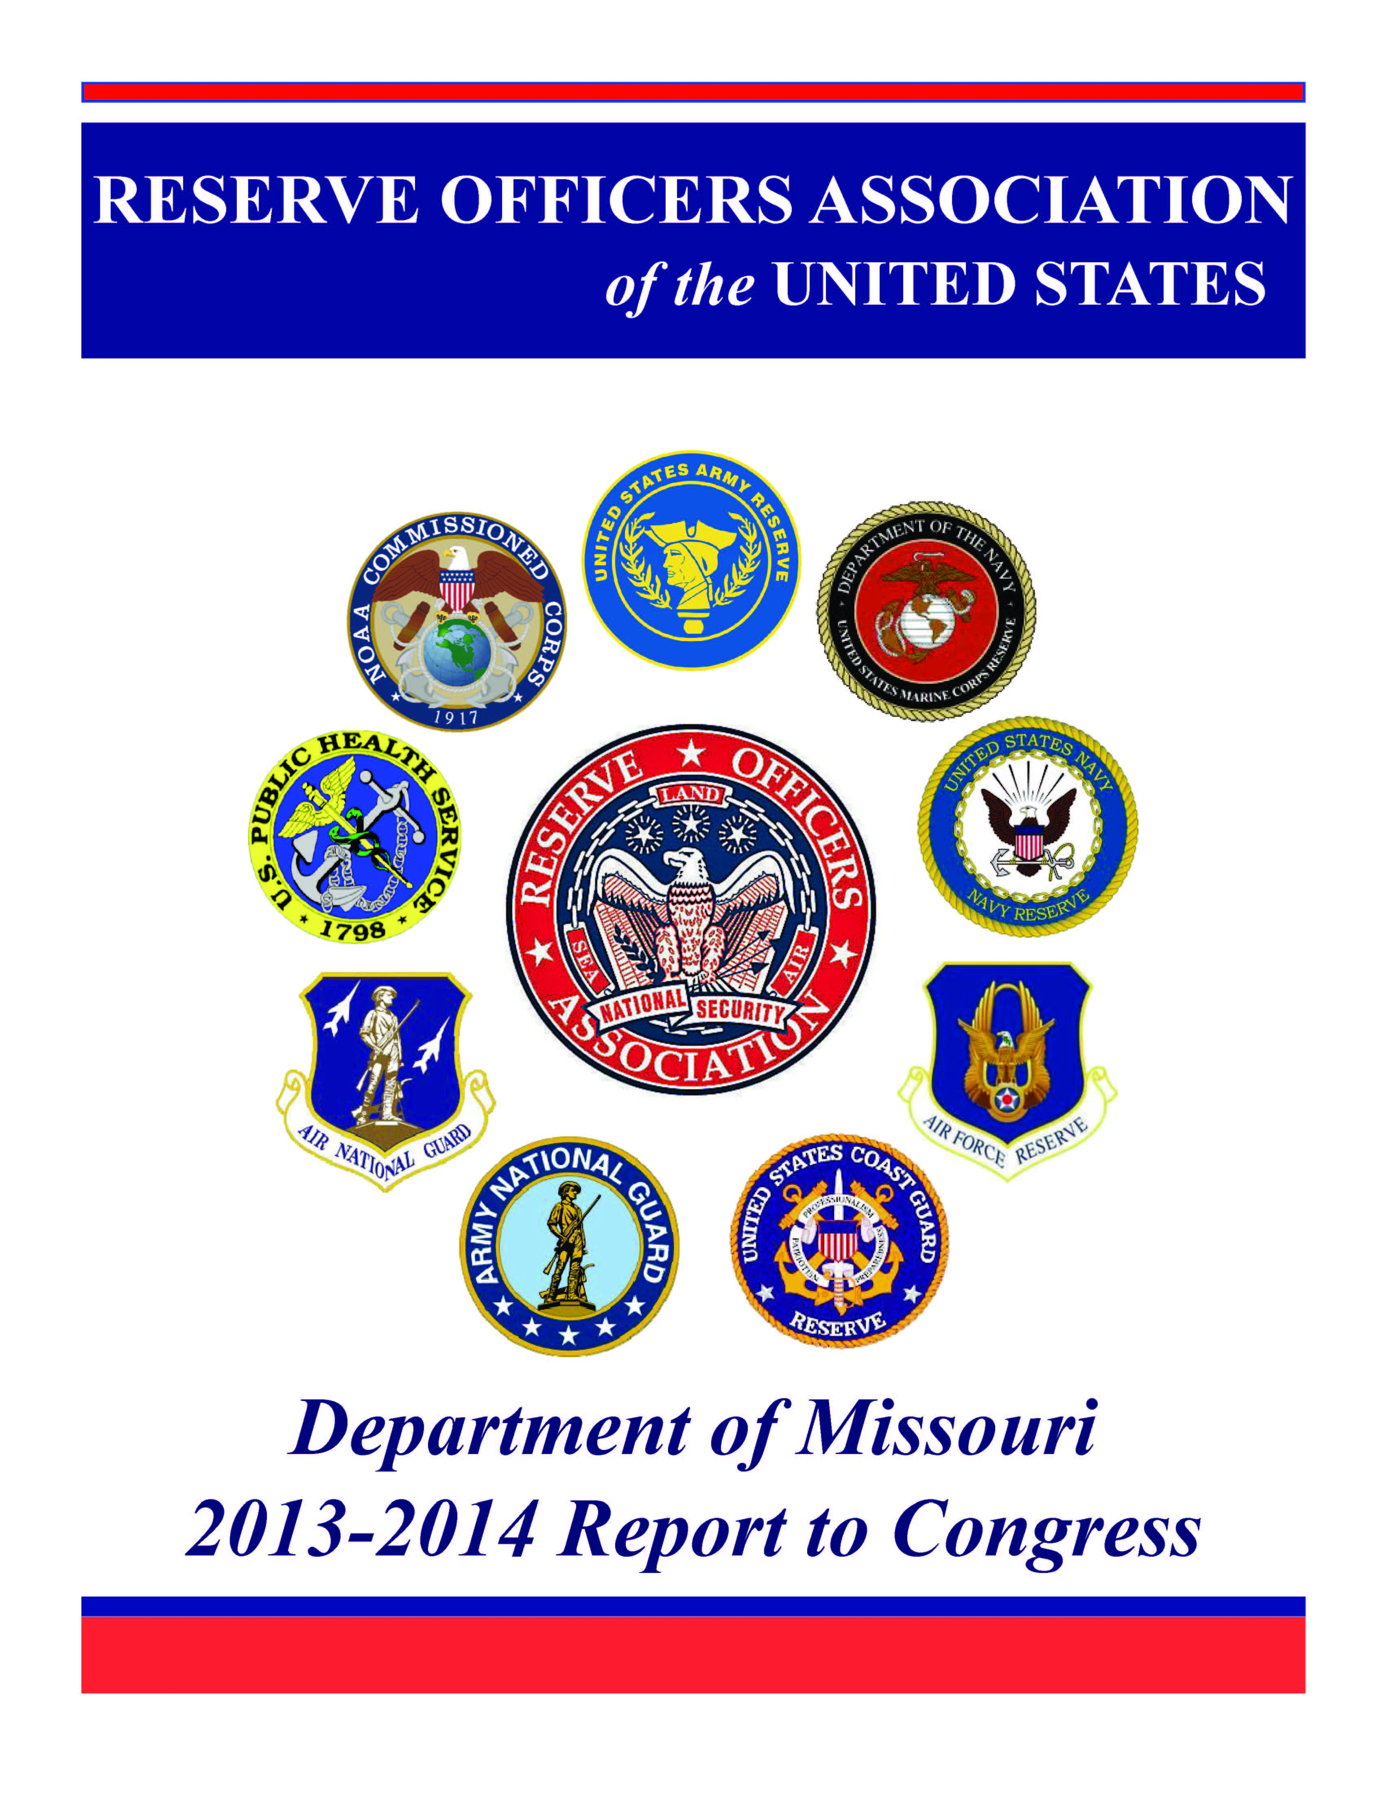
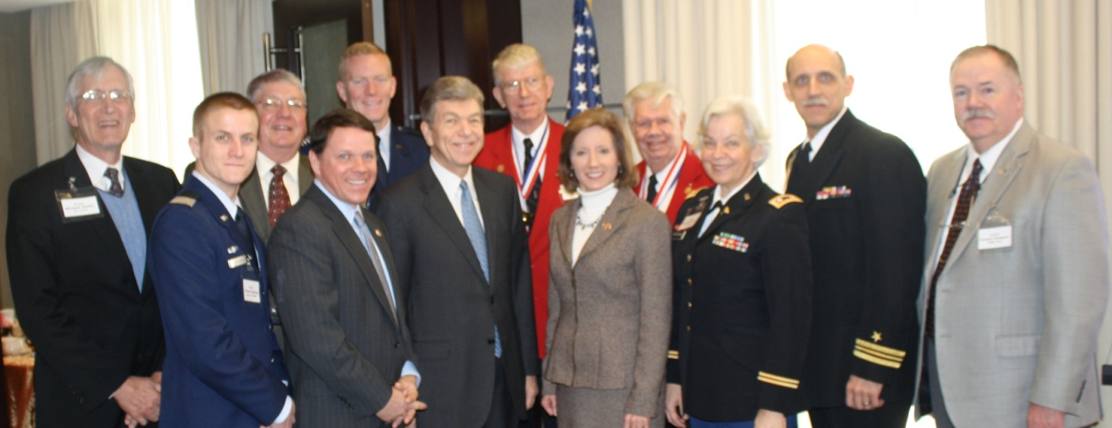
Missouri Congressional Actions
Local ROA members present “Issues & Concerns” papers to members of congress prior to and during visits to the Hill. Our primary concern is recruiting and retention during periods of high recall. Drilling reservists are surveyed for input on creditable issues they, their employers and families are faced with during long and frequent deployments.
Notes:
Local states (departments) play a key role. All politics is local! Texas has been extremely effective in having state issues passed and then having them adopted by federal. Limited copies of the Report to Congress are available Issues and Concerns letter also make a good handout

Slide 15
Insurance
    Travel (Emergency Assistance Plus)
    Life
    Disability
    Accidental Death & Dismemberment
    Hospital Income
    Long Term Care
    Major Medical
    Tricare Supplements
    Identity Theft
    Pet Insurance
What's in it for me?
  Networking
    Civilian
    Military
    Multiple Services
    International
  Resources
  Voice on the hill
  Insurance
  Law Center Reviews
  International Connection
    CIOR
Notes:
America’s Reserve Compo­nents are one of the most unique, adapt­able and operational forces in the world. At ROA, our mission is simple: support these brave men and women and their mission through a commitment to strong Reserve Components. Our focus is the resourcing, education, training, use and care of the Reserve and Guard, their families, and veterans of the Reserves. We call that Reserve Strength. Reserve Life.
Reserve Strength
Advocate for a strong national defense with a robust Reserve force as a pillar
A trusted and credible voice in the Pentagon and on Capitol Hill
Policy experts leveraging knowledge for a better Reserve force
Leaders in the effort to get the resources for a capable operational RC
A legislative agenda dedicated to the needs of Reservists
Reserve Life
A dependable source for RC career counseling, both military and civilian
A trusted source for Professional Military Education
A growing network of military professionals
Leading providers of civilian employment assistance for Reservists
Deployment and transition resources for Reservists and their families.
Affinity and lifestyle products and services

Slide 16

Professional Associations and YOU
– The Next Step
Please
Join Us
*Free 5 year membership for those under 35!
www.roa.org
Notes:
Bottom line. Professional Organizations need you as a member!
When congress asks “How many reservist belong to your organization?”
Why should I care about an issue if the reserve members themselves don’t care enough to even join your organization? NUMBERS MATTER!
We need you and your support to continue to advocate for reserve forces and reserve members.
We need to know what the current issues and concerns are.
The things I think are important may or may not be what you think are. Only by being involved can the organization keep current and relevant to those currently serving.
Expectations?
You get out what you put in. Only a member without involvement? There are several I belong to that I do nothing other than belong. ROA is my passion because I put so much of my heart and sole into the USCGR.
ROA is where I feel I have been able to make the biggest difference to my fellow reserve members and my country!
Ok, not enough time to drill let alone do anything else? Fully understand and why just belonging is better than nothing.
Look around. Who in your unit is just “putting in time”?
Everyone will get benefits of pay, retirement, but miss out on networking and so much more.
There is Good and bad in every organization, but in these you have ability to make a huge impact to both organization and nation. In my 25 year career I can tell you I had more impact on a national level doing work with ROA then I ever made with USCGR!
With these organizations you significantly increase your network. Both on civilian and military side. Attending conferences and meeting other service members at levels in your career not normally available. Social setting when off duty provides great opportunities for multiple areas of your life.
Having a social interaction with a two or three star over adult beverages is a huge opportunity to learn and potentially change something.
UNDER 35 is FREE!! For 5 years or until you reach 35.

